Slide 1

Welcome and Introduction
Pavlos Protopapas

Slide 2
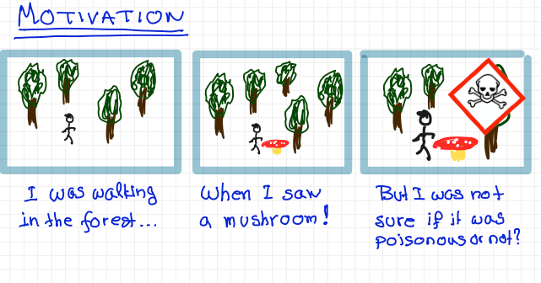

Slide 3
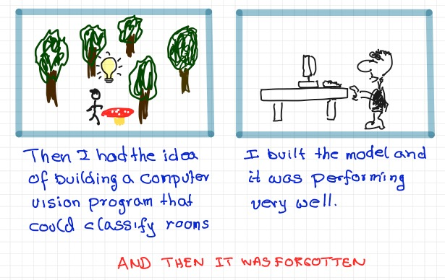

Slide 4

Mckinsey Global Survey’s findings on Adoption of AI shows nearly 25% year over year increase in the use of AI.
50% of companies spend between 8 and 90 days deploying a single AI model, with 18% taking longer than 90 days.

Slide 5
Mckinsey Global Survey’s findings on Adoption of AI shows nearly 25% year over year increase in the use of AI.
50% of companies spend between 8 and 90 days deploying a single AI model, with 18% taking longer than 90 days.
A report by IDC that surveyed 2,473 organizations and their experience with ML found that a significant portion of attempted deployments fail, quoting lack of expertise, as one of the key factors [1]
[1] (https://arxiv.org/pdf/2011.09926.pdf).

Slide 6
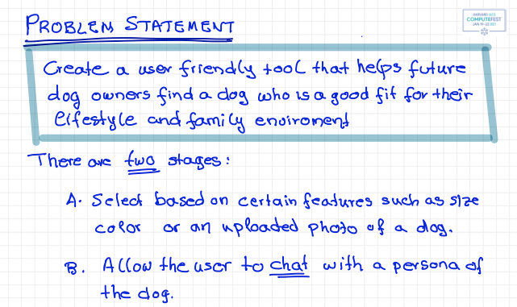

Slide 7
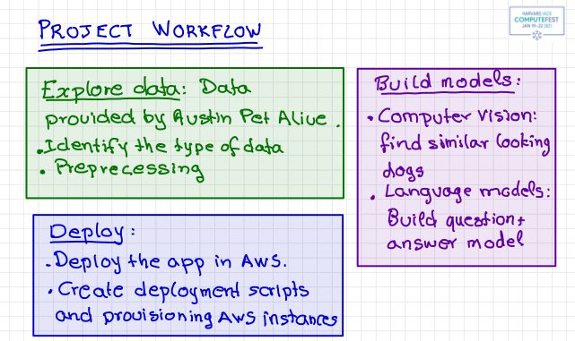

Slide 8
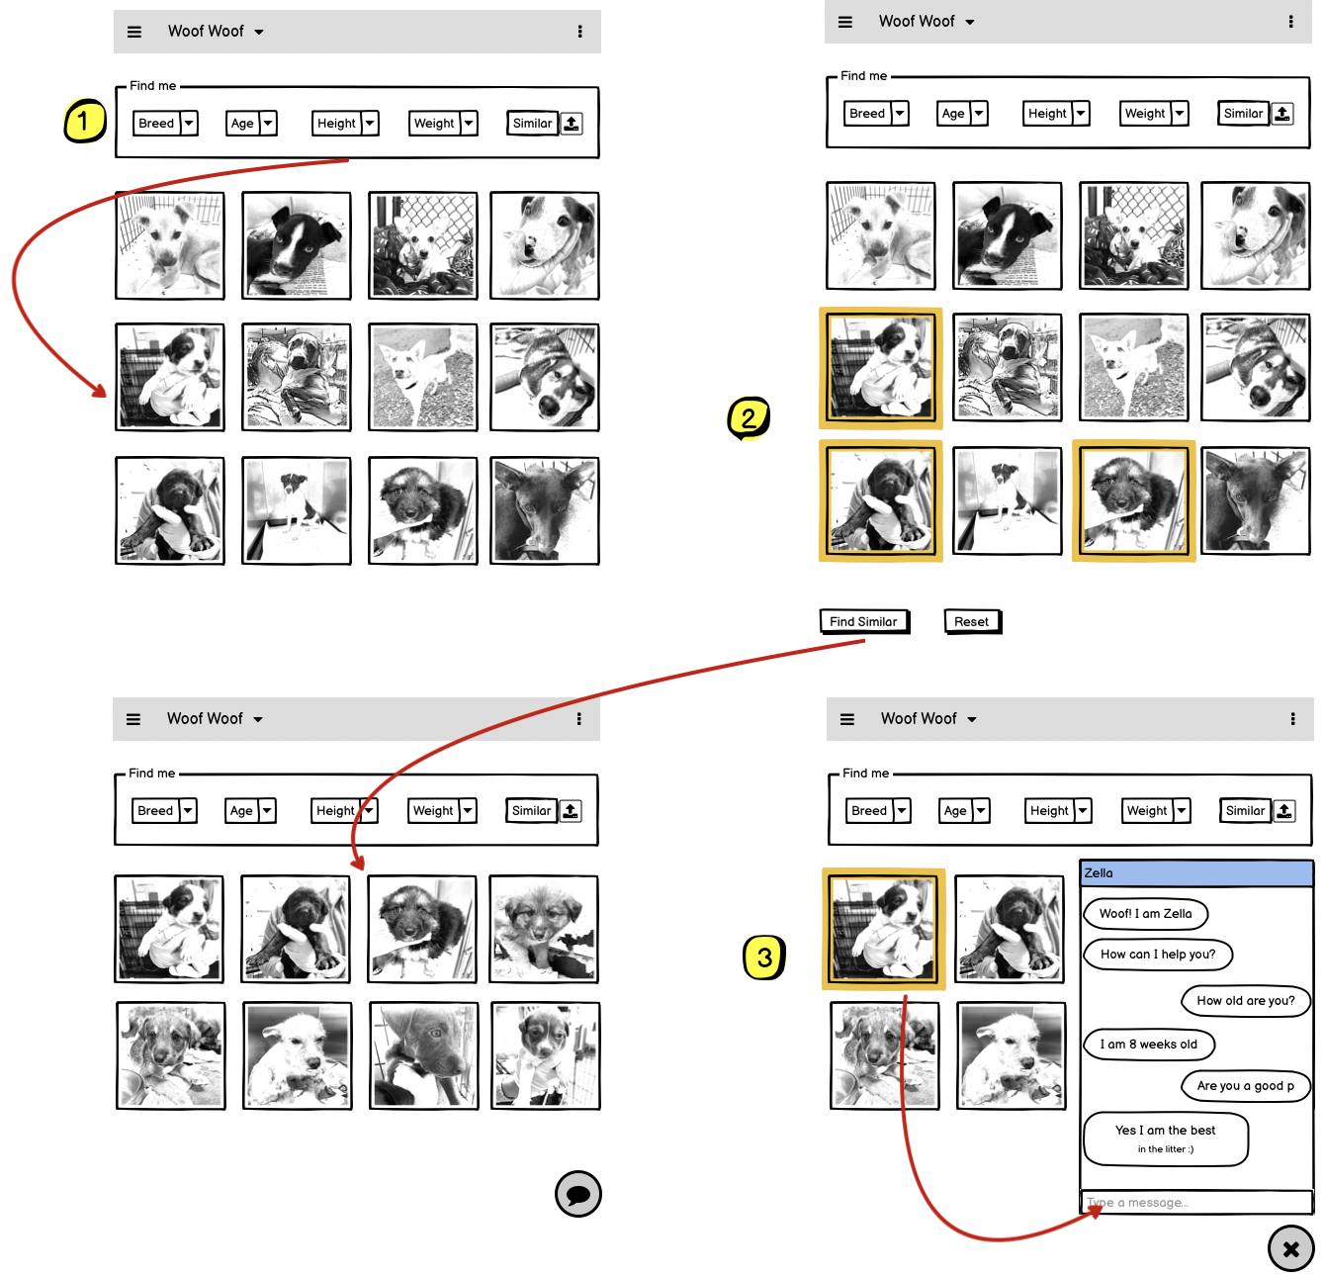
User can find dogs using “Find me” filters
Select one or more dogs to find dogs similar to the selected ones
Select a dog to chat with. This opens up a personalized chatbot for the selected dog

Slide 9
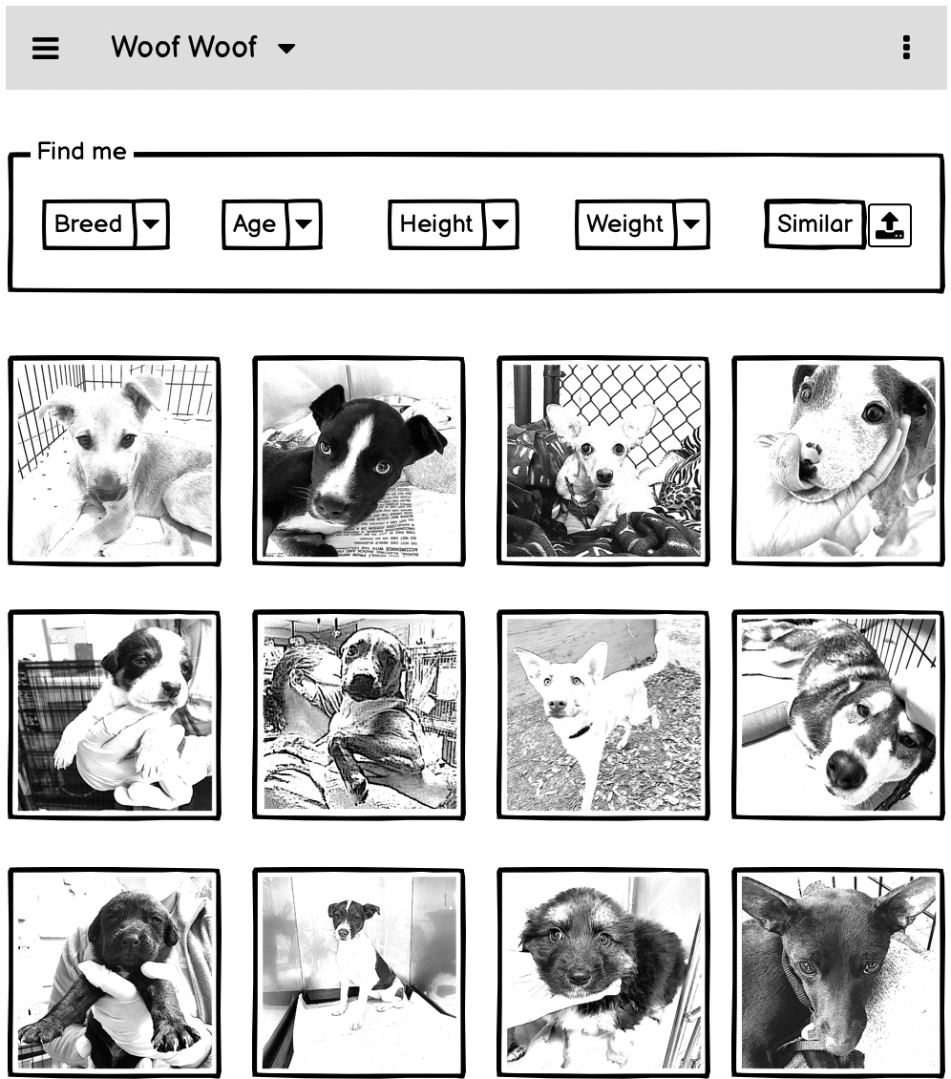
Home Page:
Default page when app starts up
Top “n” dogs shown by default
Image card displays name and image of dog
Image cards are selectable (multiple)
“Find Similar” button shows up when one or more image cards are selected
“Find me” Search/Filter:
The search/filter section will stay on each page
Allows filter by:
Breed
Age (range)
Height (range)
Weight (range)
Similar - an image upload to find dogs similar to the dog in the uploaded picture
The filter will get applied on change of any of the filter elements and refresh the image grid

Slide 10
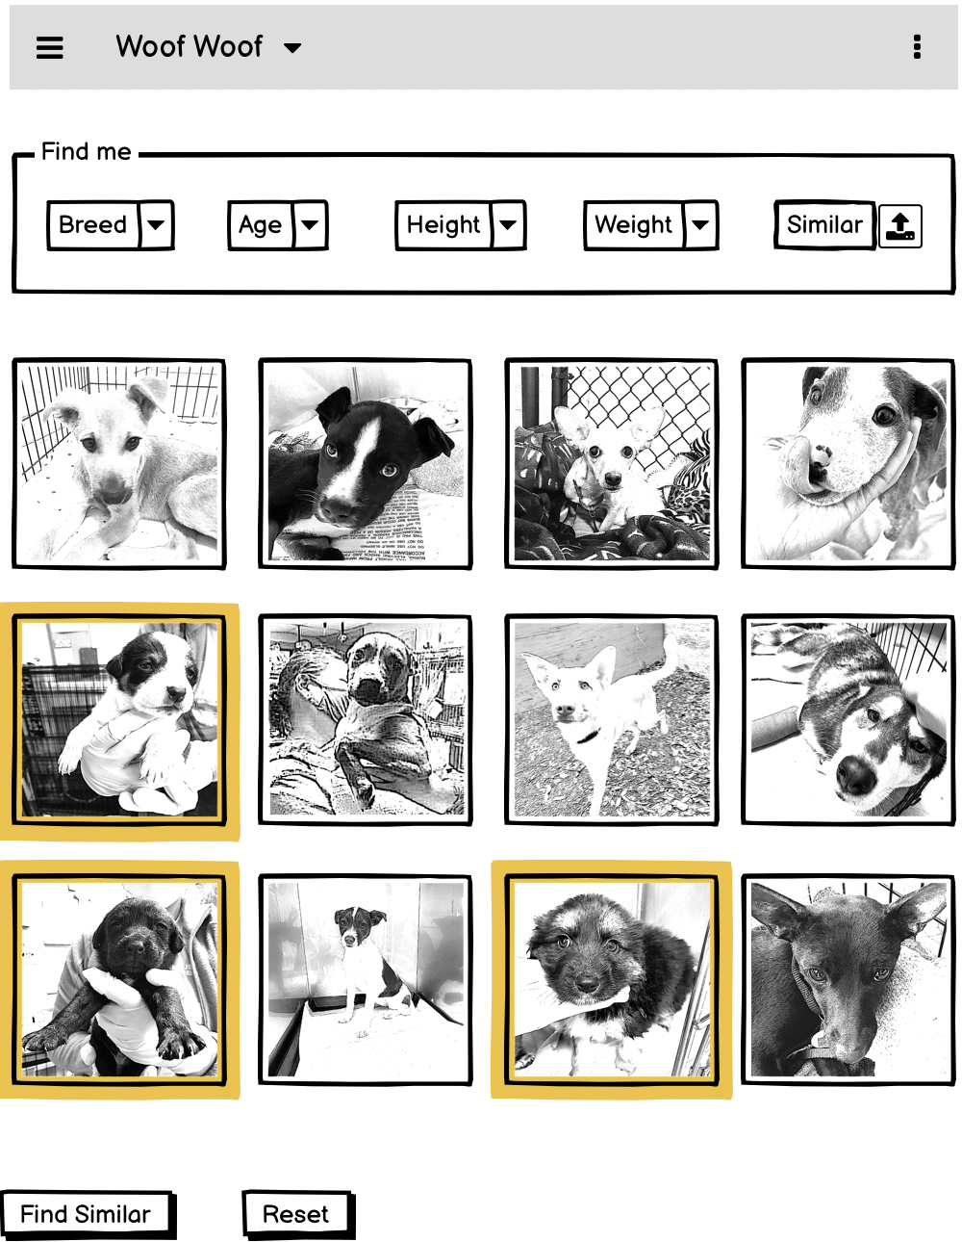
Select dogs to find more similar dogs:
Click on image grid cards to select one or more dogs
Click on “Find Similar” button to find dogs similar to the ones selected

Slide 11
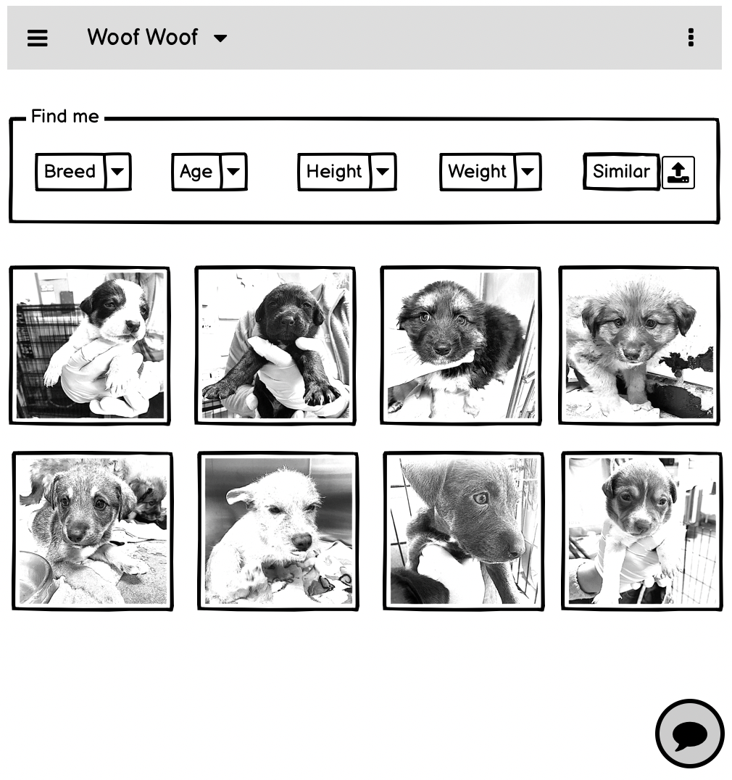
All selected dogs + top “n” similar dogs are displayed in the image grid

Slide 12
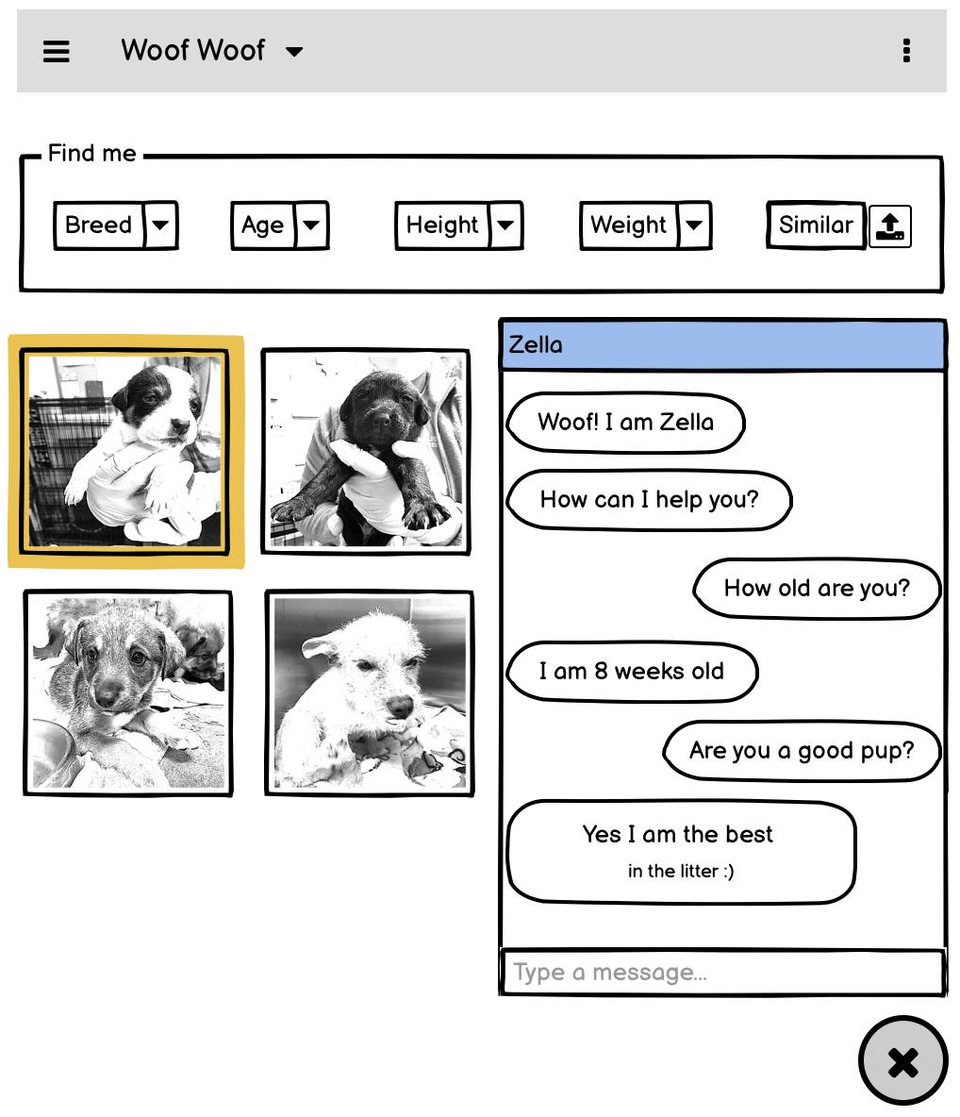
Select a dog to chat with it:
Image cards in the image grid display a “chat” icon for each dog
Click on “chat” icon to open up a chat popup
The chatbot active will be specific to the dog selected
Dog chat bot can answer basic question about itself + other general questions about the breed + some general question about dogs

Slide 13
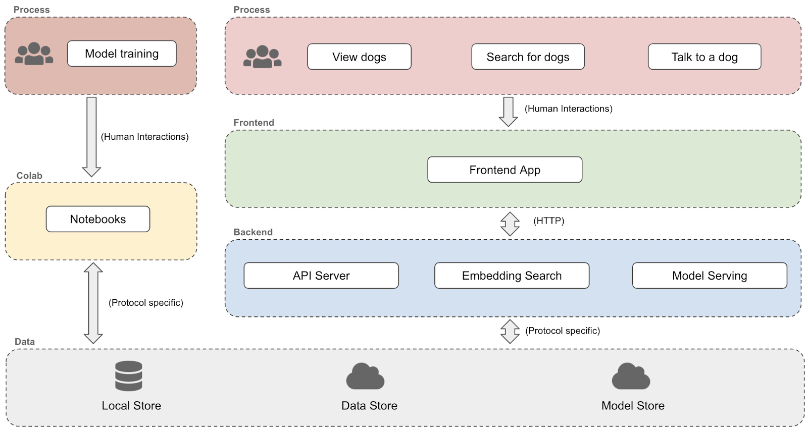
Solution Architecture

Slide 14
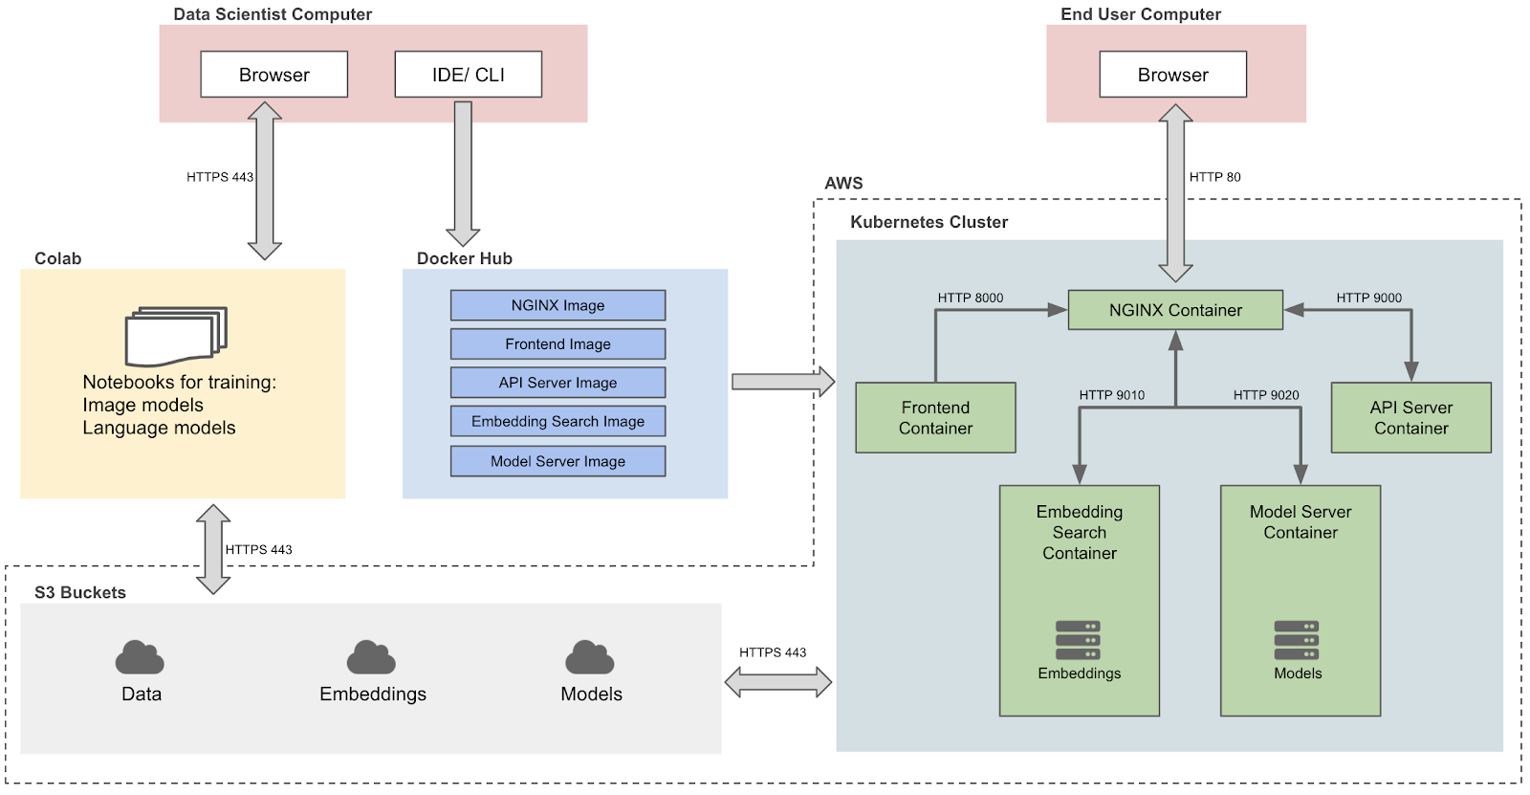
Technical Architecture
Colab:
Google Colab will be used for model training of image and language models
Trained models will be saved in AWS S3 buckets
Docker Hub:
Docker Hub will be used to host all the container images
AWS S3 Bucket Store:
S3 buckets will be used as a common storage repositories for data, embeddings, and models
Kubernetes Cluster:
Kubernetes cluster will be used to deploy the various containers on AWS

Slide 15
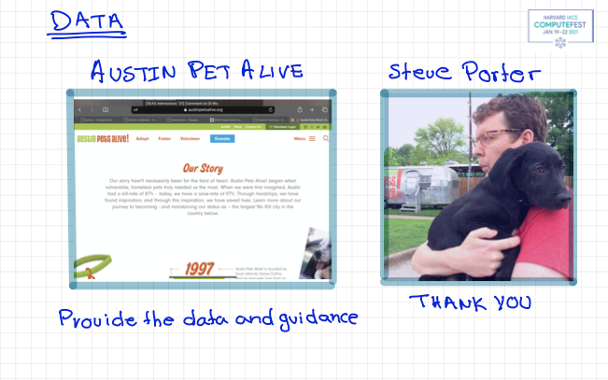

Slide 16
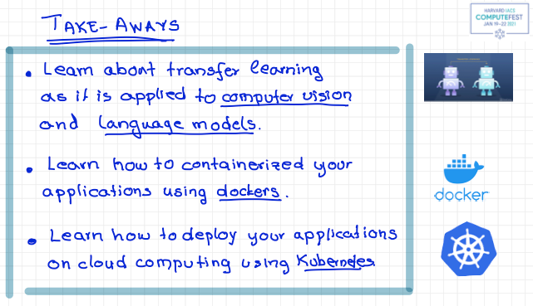

Slide 17
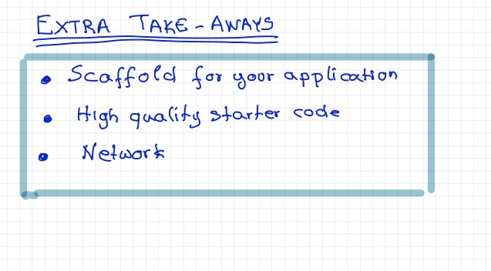

Slide 18
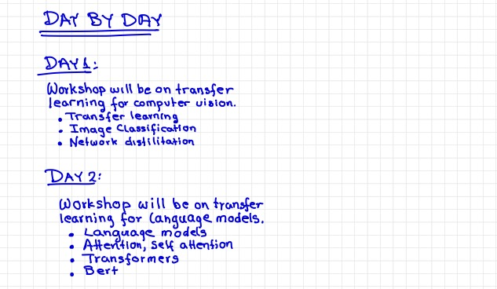
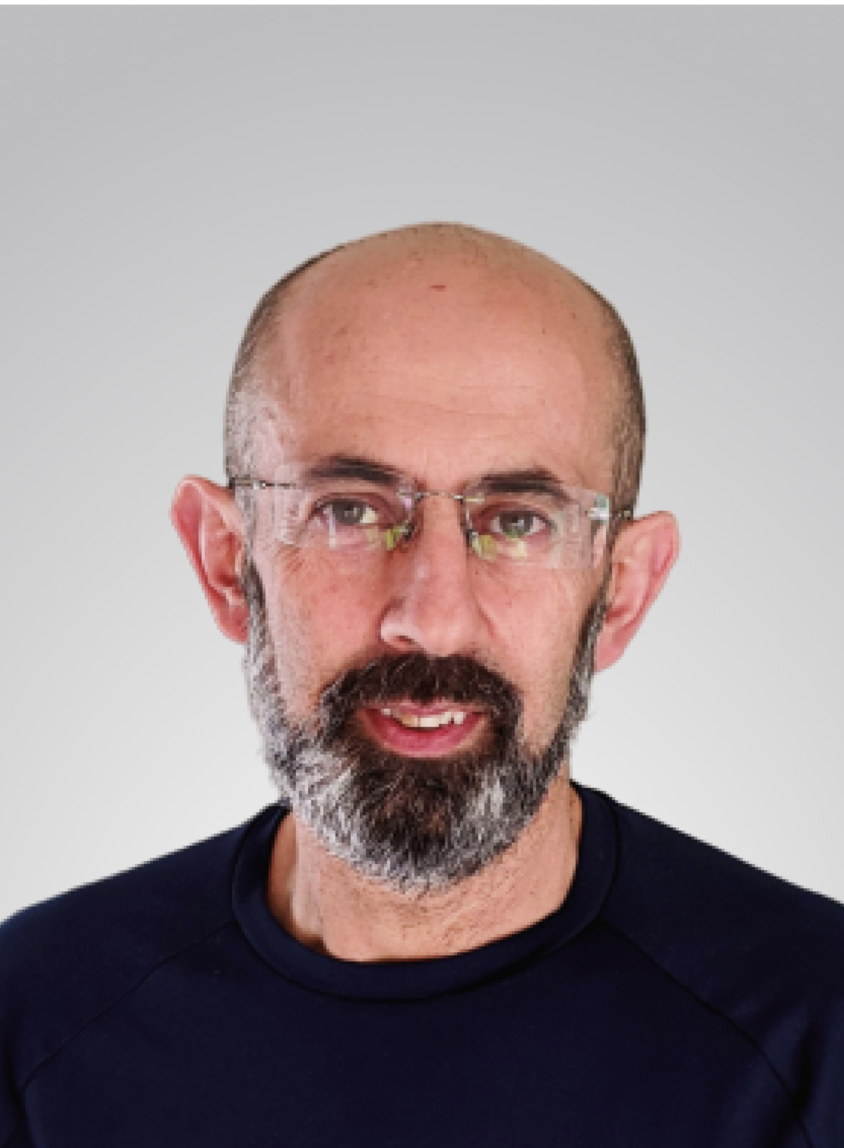
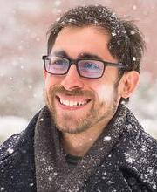
Pavlos Protopapas
Marios Mattheakis
Chris Tanner

Slide 19
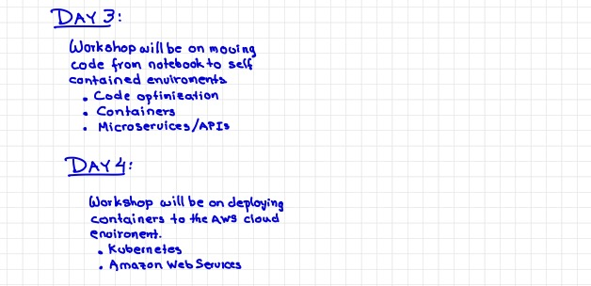
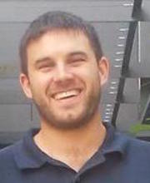
David Sondak
Pavlos Protopapas

Slide 20

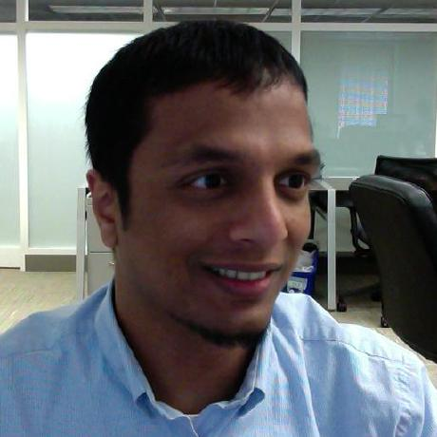
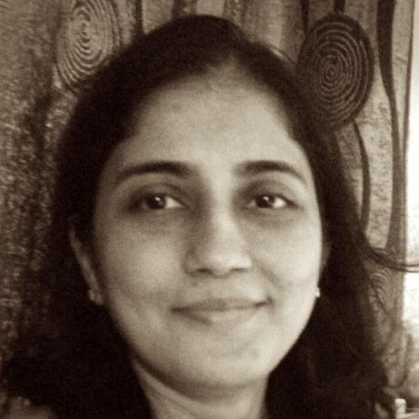
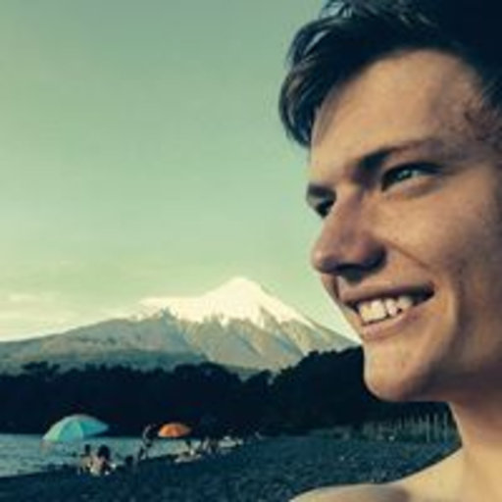
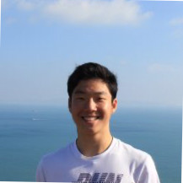
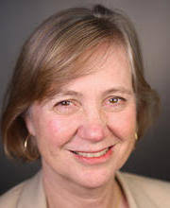
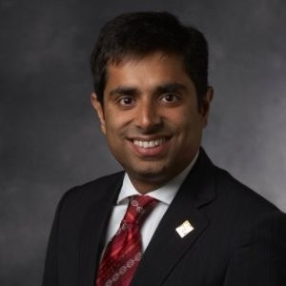
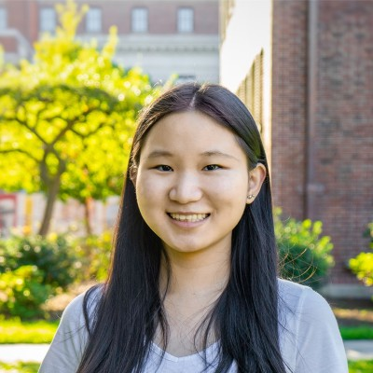
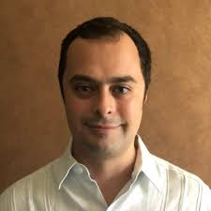
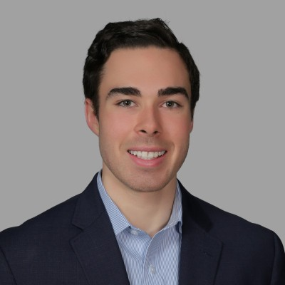


Organizers
Day 1:
Shivas Jayaram
Rashmi Banthia
Hyeden Joy
Henry Jin
Cathy Chute
Day 2:
Day 3:
Rohit Beri
Zhao Lyu
Eduardo Peynetti
Connor Capitolo
Mehul Smriti
Simon Warchol

Slide 21
GitHub, Discussion Forum and Workspace
All notebooks, links to colab, lecture notes are:
https://github.com/Harvard-IACS/2021-ComputeFest
Forum:
https://computefestforum.seas.harvard.edu
Zoom:
Check you email for zoom ids and passwords
Breakout Rooms:
https://app.sophya.world/s/ComputeFest/cafe
https://app.sophya.world/s/ComputeFest/join/ZV8Ouz8p/tfoffice
https://app.sophya.world/s/ComputeFest/join/CA0B2gpv/instructoroffice

